Slide 1
^{VENTILATION}
^{IN STEEL ROOFING}
Approaches to satisfy NCC2022 Condensation Management requirements for residential roofs in Climate Zones 6, 7 and 8

Slide 2
^{DISCLAIMER}
The information presented by the ASI, NASH and BlueScope Steel Limited has been sourced and prepared for general information only and does not in any way constitute recommendations or professional advice to any person for any purpose. While every effort has been made and all reasonable care taken to the information contained is accurate and current, this information should not be used or relied upon for any specific application without investigation and verification as to its accuracy, currency, completeness, suitability and applicability by a competent professional person.
The Australian Steel Institute Limited, National Association of Steel Framed Housing Inc. and BlueScope Steel Limited, its officers, employees, consultants and contractors and the authors and editors of the publications contained on this website do not give any warranties or make any representations in relation to the information provided herein and to the extent permitted by law (a) will not be held liable or responsible in any way and (b) expressly disclaim any liability or responsibility for any loss, damage, costs or expenses incurred in connection with this limitation, including loss, damage, costs and expenses incurred as a result of the negligence of the officers, employees, consultants, contractors, authors, editors or publishers.

Slide 3
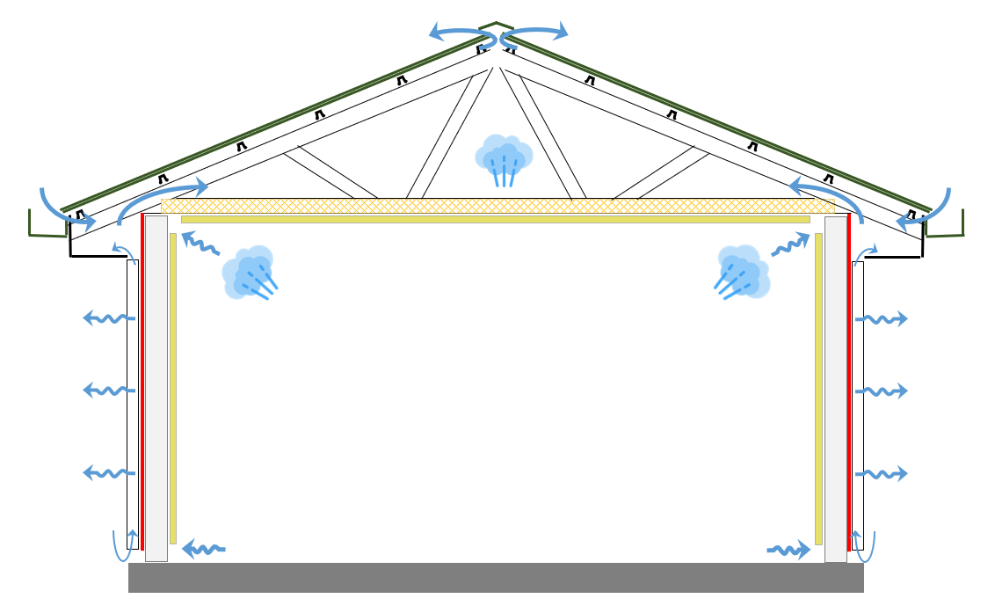
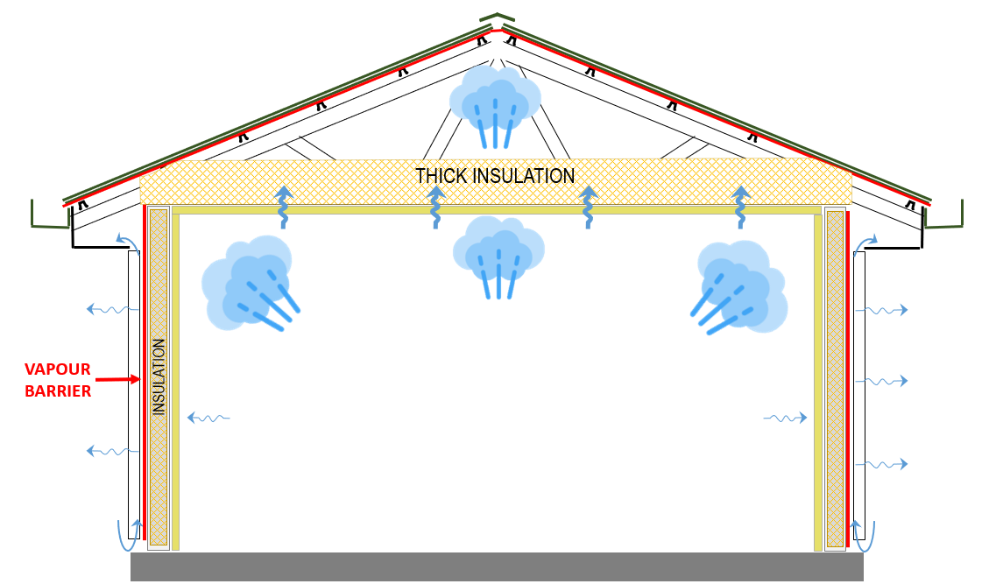
CONDENSATION RISK MITIGATION IN BUILDINGS
More energy efficient buildings is increasing the risk of condensation problems in roofs and walls.
LOW ENERGY EFFICIENCY
Leaky internal linings, naturally ventilated roof attic and wall cavities.
INCREASED ENERGY EFFICIENCY
Sealed internal linings, vapour barriers on walls and downlights drives more water vapour into the roof space. Thicker ceiling insulation and sealing of roofspace traps moisture.
Increasing insulation levels and increased air tightness.
If not managed the accumulation of condensation can become problematic
NCC2022 objective is to reduce interstitial condensation risk in buildings.
Roof Space Ventilation is being implemented to mitigate condensation risk in roofs.
Class 1, 2 and Class 4 (parts of buildings)
LOW RISK
Internal moisture
freely escapes
HIGH RISK
Moisture is restricted from escaping and drying.

Slide 4
NCC2022 VENTILATION OF ROOF SPACES
ABCB Housing Provisions Standard prescribe DtS acceptable forms of construction for NCC2022.
Exhaust systems to discharge direct to outdoor air & Roof Space Ventilation for houses in climate zones 6,7 & 8

Slide 5
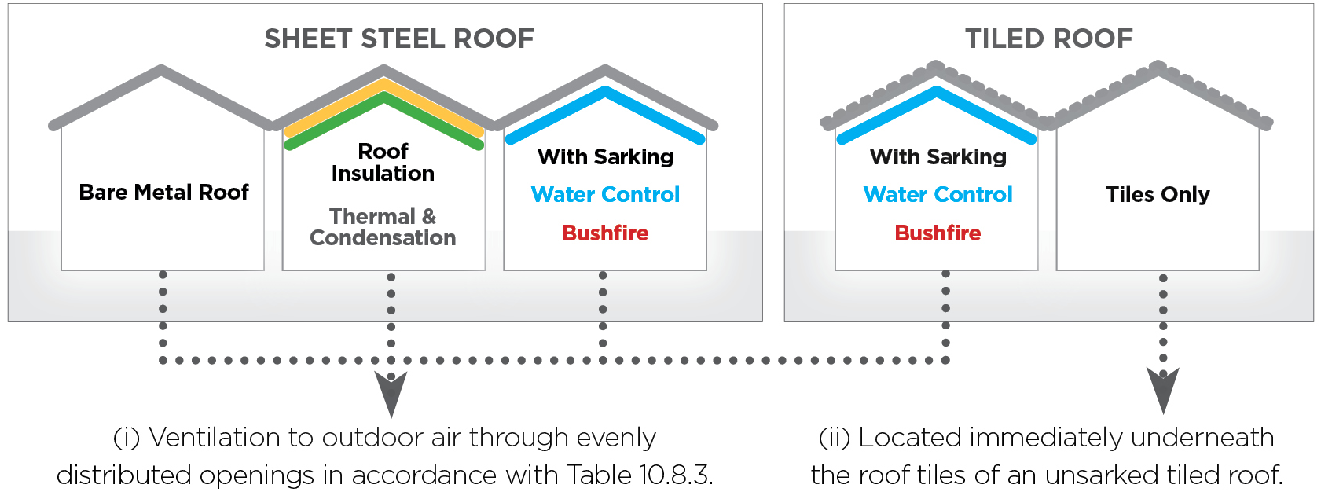
Deemed to Satisfy Compliance Paths
^{for Roof Space Ventilation}
Mainstream Housing Roof Types

Slide 6
NC2022 Roof Space Ventilation Requirements
Table Notes:
Ventilation openings are specified as a minimum free open area per metre length of the longest horizontal dimension of the roof.
For the purposes of this Table, high level openings are openings provided at the ridge or not more than 900 mm below the ridge or highest point of the roof space, measured vertically.

Slide 7
PROFILE OPENINGS PROVIDE ACCESS TO Roof ^{Space Ventilation}
Open area of Typical Corrugated Profile >7,000mm2/m
Different roof profiles provide different levels of accessible ventilation opening.
Maintaining ventilation as roof system build up increases.
Different detailing of Roof Insulation & Sarking
Integration of Passive Ventilation Devices may be required.

Slide 8
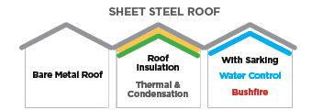
Approaches to HIGH LEVEL Ventilation
Corrugated Steel Roofing >150 Roof Pitch
ROOF PLUMBER: Detailing step during roof installation
ROOF PLUMBER: Detailing and Accessory Installation step during roof installation
ROOF PLUMBER: Installs Mechanical Vent or Smart Fan during roof installation
Roof Insulation, Thermal Membrane or Sarking cut back at batten
Roof Insulation or Thermal Membrane cut back at batten with Ridge Ventilation Accessory or Ventilation Device
BUILDER / FOLLOW ON TRADE: Installs Mechanical Vent or Smart Fan after roof

Slide 9
Approaches to LOW LEVEL Ventilation
Corrugated Steel Roofing >150 Roof Pitch
ROOF PLUMBER: Detailing and Accessory Installation step during roof installation
ROOF PLUMBER: Roof Insulation to Manufacturers Requirements and integration of ventilation device.
BUILDER / FOLLOW ON TRADE: Installs Eave / Soffit Vent
Roof Insulation to Manufacturers Requirements and integration of ventilation device.
Sarking installed to Manufacturers Requirements and Ventilation device under sarking, maintaining water drainage

Slide 10
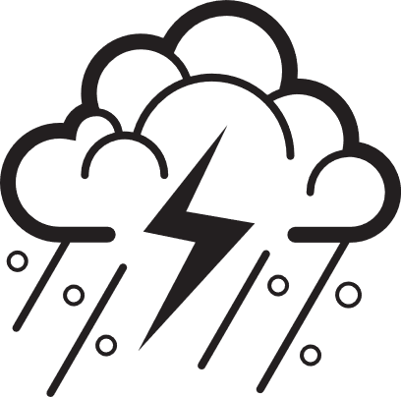
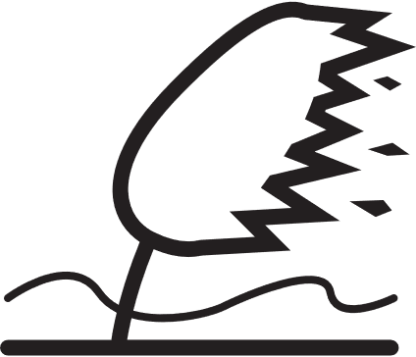
Maintaining Ventilation in a Steel Roof System
Steel Roof Systems can require accessories or specific detailing for additional functions
Application of MESHES is still allowed.
Components such as spacers,
drainage or ventilation battens are acceptable

Slide 11
^{THANK YOU}
enquiries@steel.org.au

