Slide 1
^{ENERGY EFFICIENT STEEL FRAMING}
Design principles and compliance pathways to meet NCC 2022 Energy Efficiency requirements for residential buildings
Guidance for Designers and Builders

Slide 2
^{DISCLAIMER}
The information presented by the ASI, NASH and BlueScope Steel Limited has been sourced and prepared for general information only and does not in any way constitute recommendations or professional advice to any person for any purpose. While every effort has been made and all reasonable care taken to the information contained is accurate and current, this information should not be used or relied upon for any specific application without investigation and verification as to its accuracy, currency, completeness, suitability and applicability by a competent professional person.
The Australian Steel Institute Limited, National Association of Steel Framed Housing Inc. and BlueScope Steel Limited, its officers, employees, consultants and contractors and the authors and editors of the publications contained on this website do not give any warranties or make any representations in relation to the information provided herein and to the extent permitted by law (a) will not be held liable or responsible in any way and (b) expressly disclaim any liability or responsibility for any loss, damage, costs or expenses incurred in connection with this limitation, including loss, damage, costs and expenses incurred as a result of the negligence of the officers, employees, consultants, contractors, authors, editors or publishers.
Notes:
The presentation is the result of a collaboration between the Australian Steel Institute and National Association of Steel Framed Housing

Slide 3
^{PURPOSE}
Energy Efficiency is a complex area of focus in NCC 2022 for residential buildings (Volume Two for Class 1 houses and Volume One for Class 2 apartments).
The purpose of this presentation is to provide general guidance for builders and designers. It includes:
The purpose of regulating Energy Efficiency in buildings
An overview of new NCC 2022 Energy Efficiency provisions that impact framed residential buildings
Pathways for compliance available to designers
Practical explanation of the new requirement for thermal bridging mitigation
Examples of some common easy to install construction solutions when following the DtS Elemental pathway
Reminder about thermal break requirements in certain situations
Where to go for further information
Designers and construction professionals should refer to the National Association of Steel-Framed Housing (NASH) website (nash.asn.au) for further guidance publications and presentations to enhance understanding of new requirements, tables to assist with calculations, and straightforward information on practical, cost-effective solutions.

Slide 4
PURPOSE OF ENERGY EFFICIENCY REGULATIONS
NCC regulates safety, health, amenity, accessibility and sustainability (incl operational energy)
Operational energy is used on ventilation, heating and cooling equipment to manage heat flow through the external fabric to keep the internal conditions within a comfortable range
NCC requires a minimum level of energy efficiency for new dwellings by regulating its predicted heating and cooling demand
NCC 2022 raises the required level of energy efficiency in Class 1 buildings from NatHERS 6-star to 7-star equivalent (first increase in over 10 years)
Objective is net societal benefit by saving energy and reducing carbon emissions
For framing, it’s about the external fabric properties - roof, walls and floor

Slide 5
^{New for NCC 2022}
Stringency 6-7 star
Whole of Home energy budget
Thermal bridging of framing materials
This presentation focusses on Energy Efficiency solutions using steel framed construction allowing for all new NCC 2022 requirements including thermal bridging.
NOTE that new NCC 2022 Energy Efficiency provisions come into force on different dates in each jurisdiction.

Slide 6
^{Thermal performance stringency}
Increase from 6* to 7* NatHERS equivalent
From a thermal performance perspective, when using NatHERS software as an assessment tool, Class 1 houses will generally be required to move from 6-star to 7-star energy rating.
For Class 2 apartment buildings, an average of 7 stars needs to be achieved with not less than 6 stars for any one unit.
NOTE that some jurisdictions are not currently at 6* equivalent (eg NSW and NT).

Slide 7
^{Whole of Home energy budget}
New for NCC 2022
A new “Whole of Home” approach to energy usage of the building has also been introduced which takes account of the energy consumption of fixed equipment and appliances (e.g. heating, cooling, hot water, cooking, lighting, pool & spa equipment).
It’s a scorecard system, with points for more efficient appliances. A score of at least 60/100 is required.

Slide 8
^{Thermal bridging}
New for NCC 2022 residential buildings
Currently applies to both STEEL and TIMBER framing in non-residential buildings
When a building element contains framing members with lower thermal resistance than surrounding materials, more heat is conducted through these members.
This effect can reduce the thermal performance of the insulation layer and is commonly referred to as “conductive thermal bridging”.
Commonly used frames of timber and steel both exhibit conductive thermal bridging, the effect being more pronounced with steel members.

Slide 9
Thermal bridging measures for steel framed dwellings
In NCC 2019 – for dwellings - thermal resistance for timber and steel framed elements is calculated through the insulation path, with requirement for adding thermal breaks to steel framing in specific situations.
For NCC 2022, the method of determining the thermal resistance of steel-framed building elements will require account of the conductive thermal bridging of the frame. This is a job for designers and suppliers.
Industry bodies like NASH and ASI do the heavy lifting here, making the job easy for the building designer and builder.
NOTE : The requirement for thermal breaks remains unchanged (since BCA 2006).

Slide 10
^{ENERGY EFFICIENCY SOLUTIONS}
Performance Solution (not covered here)
Deemed-to-Satisfy (DtS) Solution:
DtS NatHERS, or
DtS Elemental

Slide 11
^{DtS NatHERS Solutions}
Thermal Performance Assessors use NatHERS Accredited software to model the heating and cooling energy demand
Building design details are loaded into software screens and a star rating produced – for NCC 2022 that’s 7-star minimum
NOTE: In NSW, this option may be used to satisfy the thermal performance standards of BASIX.
Trade-offs are permitted between roof, wall and floor insulation and windows to achieve the rating
NOTE that different software systems may provide slightly different results for steel due to the release timetables for new features.

Slide 12
^{DtS NatHERS PATH}
There are four Accredited NatHERS software systems:
AccuRate (CSIRO)
FirstRate5 (Sustainability Victoria)
BERS Pro (Energy Inspection)
Hero (Hero Software)
All systems use the same underlying “thermal engine” but user screens and preliminary calculations are different
Refer to the NatHERS website for software availability:
https://www.nathers.gov.au/accredited-software

Slide 13
^{DtS NatHERS PATH}
NASH worked with the BlueScope Applications Team to develop a NatHERS Software Modelling Guide
As systems have different input screens, the guidance needs to be tailored somewhat for each software
Engaging with NatHERS Administrator to incorporate this guidance into the Assessor Handbook

Slide 14
^{DtS elemental PATH}
Lookup tables in the ABCB Housing Provisions Standard, based on Climate Zone and building geomentry
Design one element at a time - no trade-offs between building elements or glazing
Tables assume timber construction. When steel is used, additional measures are required:
Prescribed mitigation measures, such as additional insulation, or
Total R-Value calculation to meet specified value

Slide 15
Practically what will it mean for solutions and processes?
Simple, practical solution examples - to show changes from a builder perspective will in most cases be minimal for steel framed houses

Slide 16
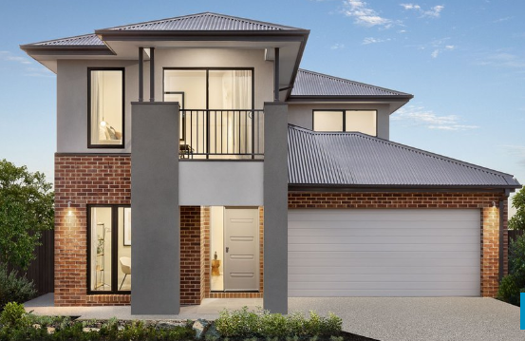
^{DtS Elemental Solutions}
^{DtS elemental PATH}
ROOF TYPE
EAVE WIDTH
ROOF COLOUR
(SOLAR ABSORPTANCE)
WALL
MATERIAL
ROOF
VENTILATION
WALL COLOUR
(SOLAR ABSORPTANCE)
ROOF REFLECTIVE
INSULATION
WALL
HEIGHT
Photo acknowledgement: JG KING HOMES

Slide 17
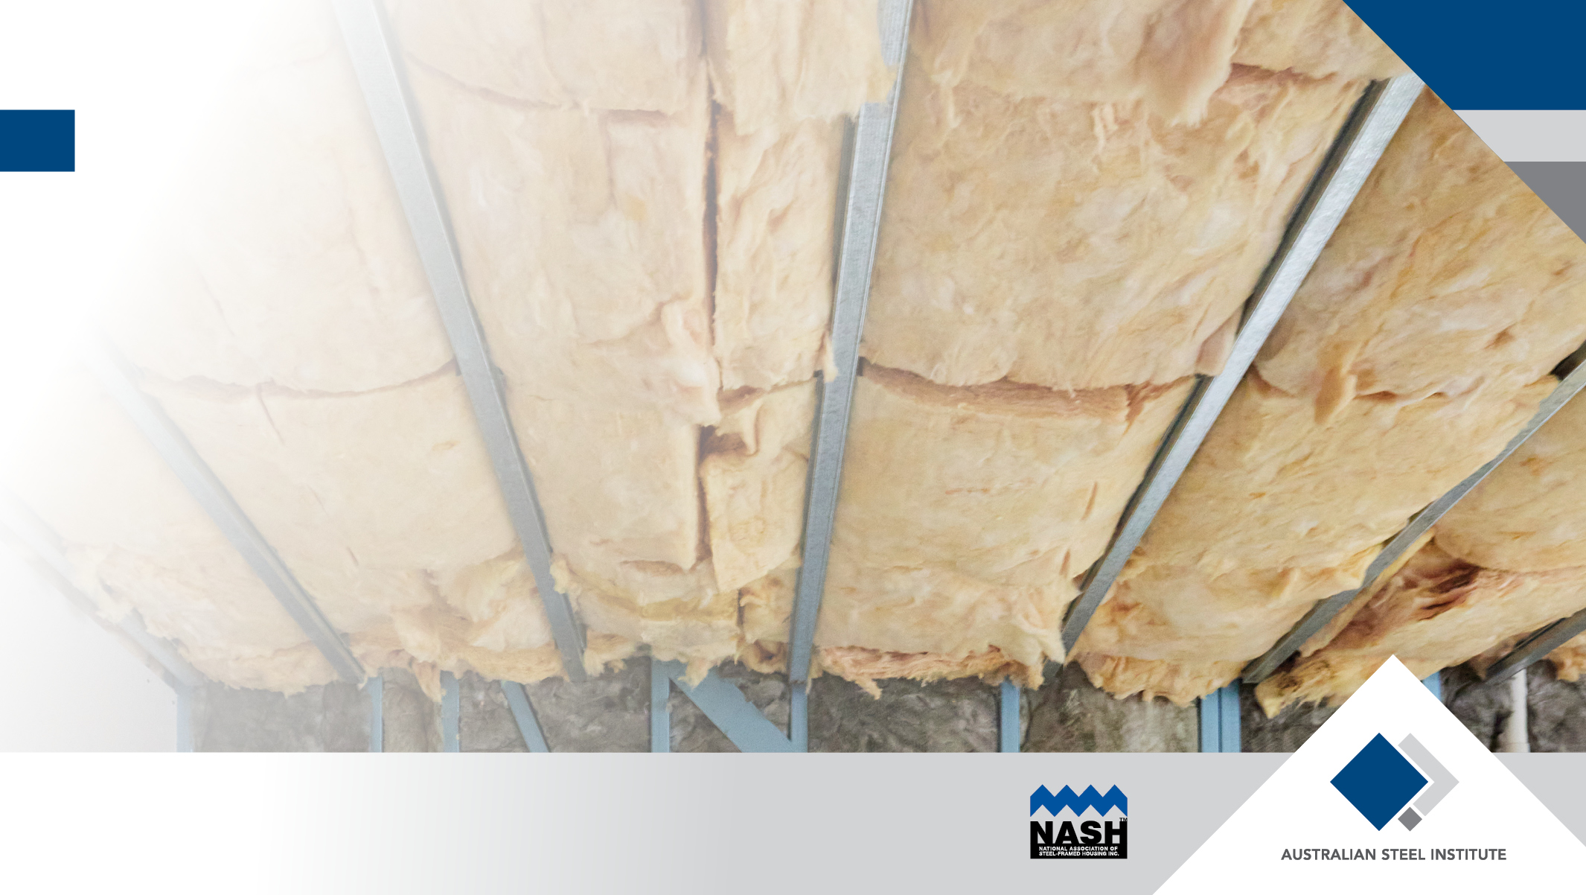
^{Roofs & Ceilings}

Slide 18
DtS Elemental - TIMBER CEILINGS
ROOF
TYPE
ROOF
COLOUR
(SOLAR ABSORPTANCE)
ROOF
VENTILATION
INSULATION SOLUTIONS FOR MOST CASES –
CZ 5 EXAMPLE
Table Notes:
SA=Solar Absorbtance
A roof is considered ‘vented’ if it: (a) has one wind-driven roof ventilator per 50m2 of ceiling area, with gable, eave or ridge vents; or (b) has one powered roof ventilator per 200m2 of ceiling area, with gable, eave or ridge vents; or (c) is a tiled roof without sarking-type material at roof level.
If a roof is not ‘vented’, it is a ‘standard’ roof.
The R-Value of reflective insulation is not to be included in the R-Value of any under-roof ceiling insulation.
R-Values listed are for the labelled, declared R-Value of insulation.
ROOF REFLECTIVE
INSULATION

Slide 19
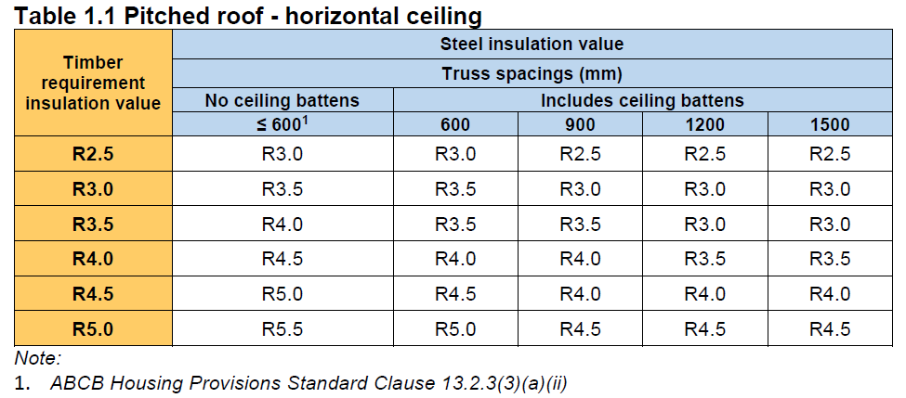
^{TRUSSED ROOF Solutions}
PITCHED TRUSSED ROOF, HORIZONTAL CEILING
In most Climate Zones, timber solution requires R2.5 to R4.0
Steel trusses at <= 600: add R0.5
Steel trusses at wider spacing: Same insulation as timber or less

Slide 20
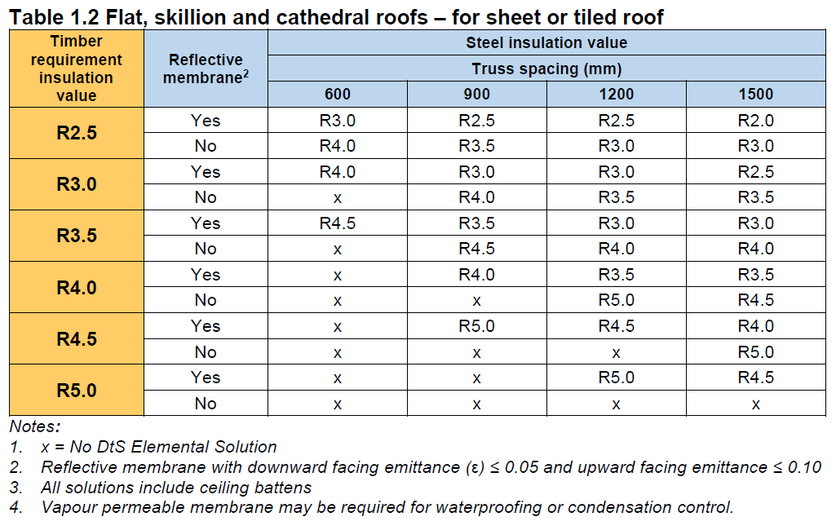
^{RAFTERED ROOF Solutions}
RAFTERED ROOF, SLOPING CEILING
In most Climate Zones, timber solution requires R2.5 to R4.0
Steel rafters at 600: Up to R1.5 more than timber
Steel rafters at 900 – 1500:
Without reflective membrane: Up to R1.0 (typically R0.5) more than timber
With reflective membrane: Typically same insulation as timber
Steel rafters at 600 – 1500 with roofing blanket: Same or up to R0.5 less than timber

Slide 21
^{Wall solutions}

Slide 22
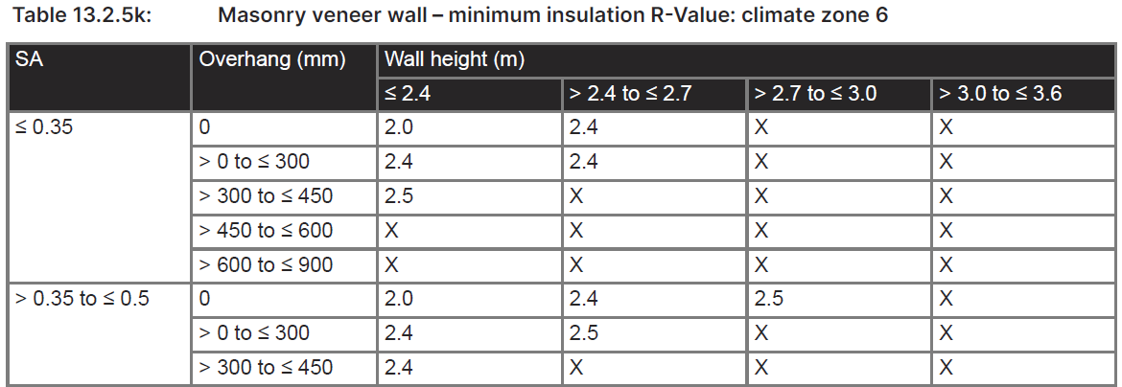
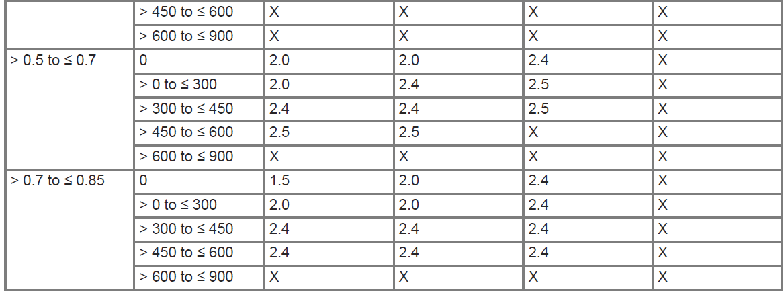
^{DtS Elemental - TIMBER walls}
WALL
TYPE
WALL HEIGHT
WALL COLOUR
INSULATION SOLUTIONS FOR 2.5m WALL HEIGHT and SA = 0.6
CZ 6 EXAMPLE
EAVE OVERHANG

Slide 23
^{BRICK VENEER WALL Solutions}
In most Climate Zones, timber solution requires R1.5 to R3.5
With reflective membrane (ε < 0.2), use same insulation as timber
Lower emissivity membranes require less insulation

Slide 24
^{CLAD WALL Solutions}
In most Climate Zones, timber solution requires R1.8 to R3.8
Steel framing with battened reflective airspace requires same or less wall insulation than timber (Also, due to wall depth, some 7-star solutions may be possible in steel but not timber)
Continuous insulation options require same insulation as timber
For cladding directly fixed to studs, thermal breaks continue to be required as per NCC 2019.

Slide 25
NCC 2022 DTS Elemental solution – Timber vs Steel
^{Climate ZONE 2}
Ventilated sheet steel roof Truss spacing 900
No roof-level insulation
No reflective roof membrane
Roof Solar Absorptance 0.5
Wall Solar Absorptance 0.6
Single storey, wall height 2700
Eaves 600

Slide 26
NCC 2022 DTS Elemental solution – Timber vs Steel
^{Climate ZONE 5}
Ventilated sheet steel roof Truss spacing 900
No roof-level insulation
No reflective roof membrane
Roof Solar Absorptance 0.5
Wall Solar Absorptance 0.6
Single storey, wall height 2700
Eaves 600

Slide 27
NCC 2022 DTS Elemental solution – Timber vs Steel
^{Climate ZONE 6}
Ventilated sheet steel roof Truss spacing 900
No roof-level insulation
No reflective roof membrane
Roof Solar Absorptance 0.5
Wall Solar Absorptance 0.6
Single storey, wall height 2700
Eaves 600

Slide 28
Apartment (Class 2) walls/facades
External walls of Class 2 apartments are treated differently to houses. To determine the required R-Value of the opaque wall portion, the designer needs to consider one of two area-based methods:
Ratio of opaque wall area to floor area – plus separate glazing requirements
Ratio of opaque wall area to total wall-glazing area.
These methods give different results depending on building geometry. Designers would typically use calculation tools and tables provided by industry to determine suitable compliant design solutions.
NOTE that the requirement to consider the effects of thermal bridging for apartment external walls applies equally to timber and steel framed construction when using the DtS Elemental pathway.

Slide 29
Thermal breaks – NO CHANGE for NCC 2022
The NCC requires that thermal breaks be used in specific situations.
A thermal break, of minimum R-value 0.2, is required where lightweight cladding and lining are directly attached to the same steel member (eg, stud, rafter) or the building is unlined.
The presence of any secondary member (eg cladding batten or lining batten) made from any material negates the requirement for a thermal break.
This applies to both walls and roofs of residential buildings and has been unchanged since BCA 2006.
Thermal breaks improve the overall thermal performance of a steel framed roof or external wall element. More importantly, they reduce the potential for areas of low temperature to form on internal wall or ceiling surfaces, attracting condensation.

Slide 30
^{Thermal breaks}
No change for thermal breaks BCA 2006 - NCC 2022

Slide 31
^{In summary….}
There are cost-effective solutions based on DtS Elemental pathway.
For most common forms of residential construction, changes to steel-framed construction practice and insulation levels will be minimal.
No complex, costly tasks on site for builders to achieve compliance
Just take care to install:
thermal breaks where required (no change to current requirements)
specified bulk or continuous insulation and
appropriate membranes (facing correctly as per label instructions)
NASH NTN-006 contains DtS Elemental solutions for designers (for Class 1 houses) and NASH is available for assistance where required.
Guidance material is under way for NatHERS software and for Class 2 (apartment) Elemental solutions.

Slide 32
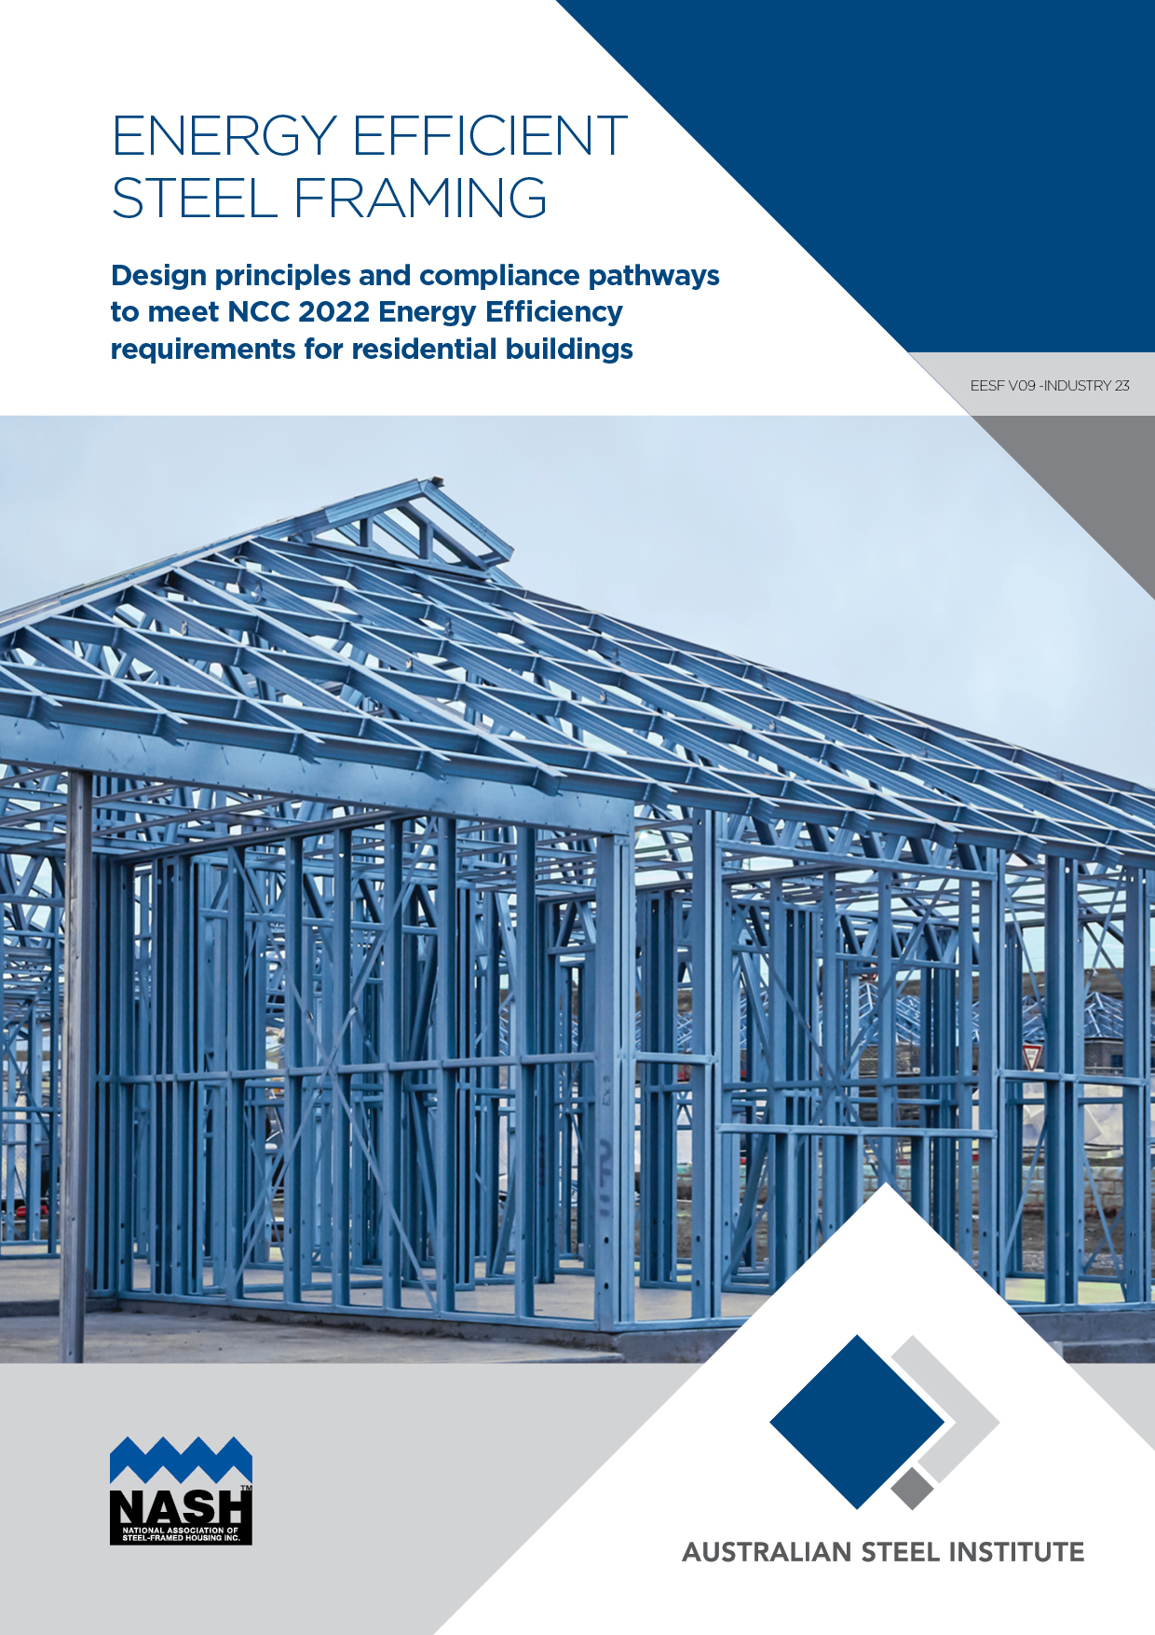
^{THANK YOU}
info@nash.asn.au

