Slide 1
^{Condensation Management for}
^{steel roofing}
Principles and approaches for managing moisture in Australian residential steel roof systems

Slide 2
^{DISCLAIMER}
The information presented by the ASI, NASH and BlueScope Steel Limited has been sourced and prepared for general information only and does not in any way constitute recommendations or professional advice to any person for any purpose. While every effort has been made and all reasonable care taken to the information contained is accurate and current, this information should not be used or relied upon for any specific application without investigation and verification as to its accuracy, currency, completeness, suitability and applicability by a competent professional person.
The Australian Steel Institute Limited, National Association of Steel Framed Housing Inc. and BlueScope Steel Limited, its officers, employees, consultants and contractors and the authors and editors of the publications contained on this website do not give any warranties or make any representations in relation to the information provided herein and to the extent permitted by law (a) will not be held liable or responsible in any way and (b) expressly disclaim any liability or responsibility for any loss, damage, costs or expenses incurred in connection with this limitation, including loss, damage, costs and expenses incurred as a result of the negligence of the officers, employees, consultants, contractors, authors, editors or publishers.

Slide 3
Condensation Management Principles in Steel Roofing
Steel Roofing is robust and versatile. There are different approaches available to address condensation risk in roofs.
Inform building practitioners of;
Fundamental principles of water vapour and condensation management in steel roofs.
Water Vapour and Condensation Management in different steel roof systems.
Address roof condensation myths

Slide 4
WHAT IS CONDENSATION AND WHEN IS IT A PROBLEM?
Condensation occurs when water changes state from a vapour into a liquid.
For condensation to occur it requires two sets of conditions:
^{It is a problem if:}
It accumulates and cannot dry
Gets trapped in a wall or roof system (interstitial condensation).
There are longer periods of wet weather in cooler climates with less drying forces.
The presence of water vapour in the air
A cold surface that is below the dew point of the air.

Slide 5
^{DESIGN PRINCIPLES FOR}
^{MOISTURE MANAGEMENT IN ROOFS}
Steel roofs can be part of system that can mitigate condensation risk while meeting other performance requirements
Fundamental Moisture Management Principles:
Keep moisture out
Allow moisture that enters to escape
Minimise the risk of condensate forming

Slide 6
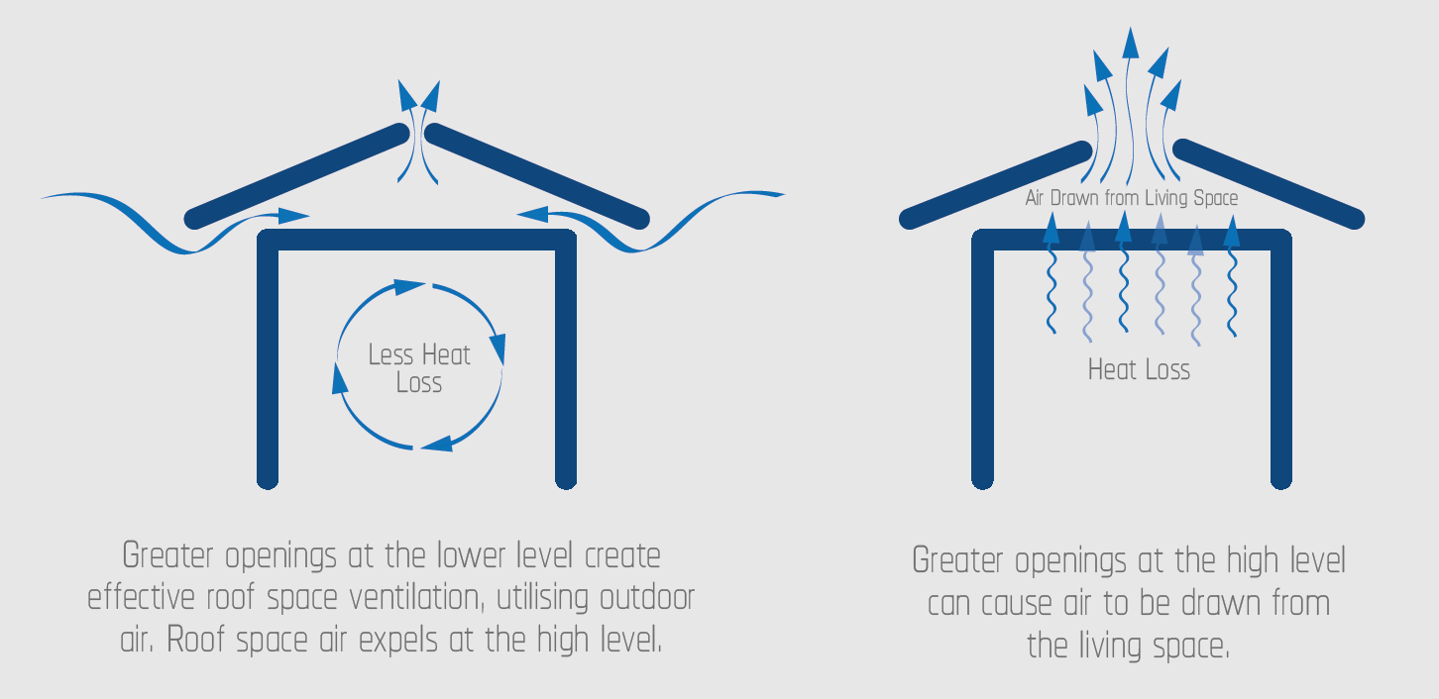
^{EFFECTIVE VENTILATION OF ROOFS}
Roof types with lower inherent robustness will require additional design consideration and risk mitigation.
Fundamental Ventilation Principles:
Low level ventilation should be greater than the high level ventilation.
Ventilation should be distributed to avoid pockets of stagnant air.
Air gap providing unrestricted airflow.

Slide 7
Fundamental principles of moisture management can be applied across different roof types.
Roof types with lower inherent robustness will require additional design consideration and risk mitigation.
Increased roof pitch improves the natural draining potential while also creating the opportunity for improved air movement, ventilation.

Slide 8
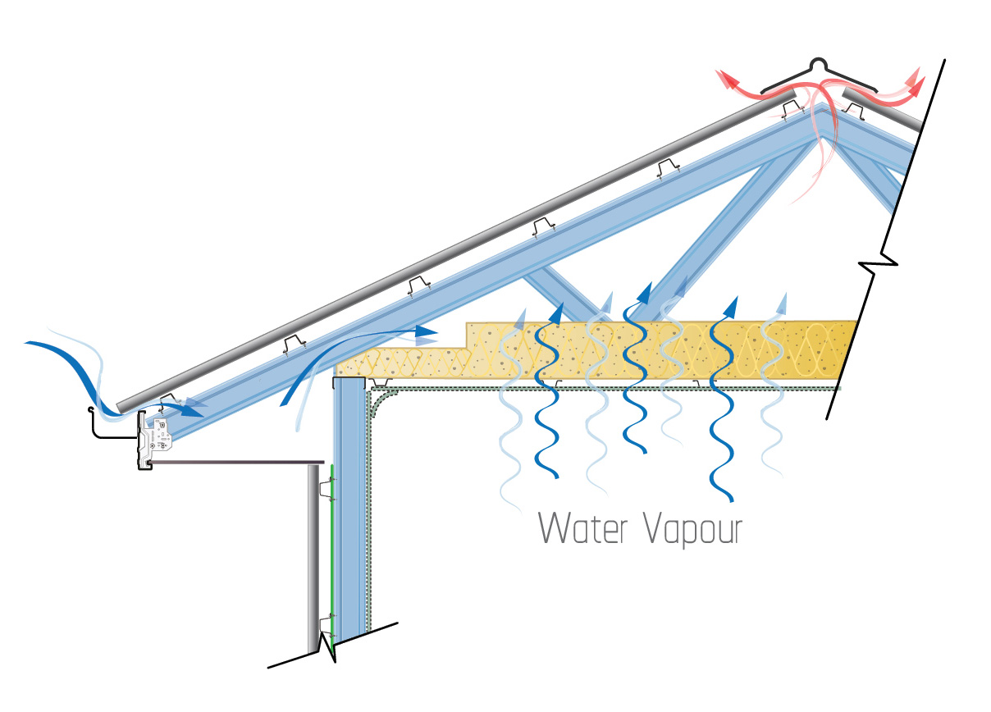
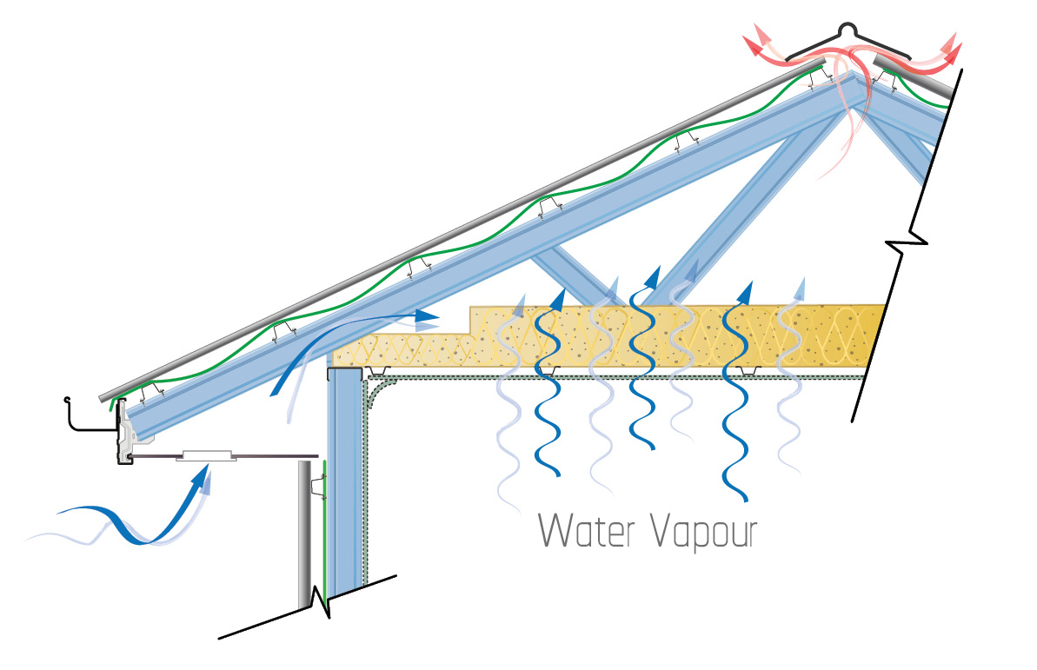
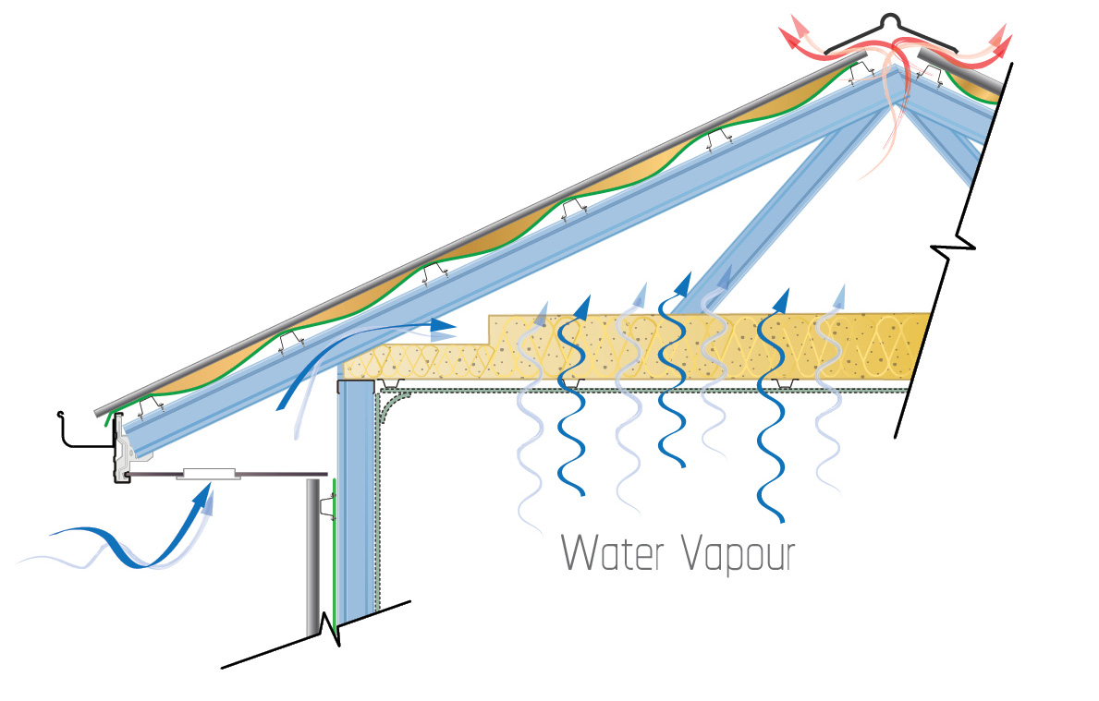
Approaches Are Available to Increase Robustness of Steel Roofs to Condensation Risk
GOOD
BETTER
BETTER
Bare steel clad roof Natural Roof Attic Ventilation
Steel clad roof with reflective foil under roof
Roof Attic Ventilation is necessary. Thermal Buffer from the Cold Roof Sheet Thermal Benefit
Steel clad roof with BLANKET & foil under roof
Roof Attic Ventilation is necessary. Greater thermal insulation for higher risk roofs. Higher Thermal | Acoustic Benefit

Slide 9
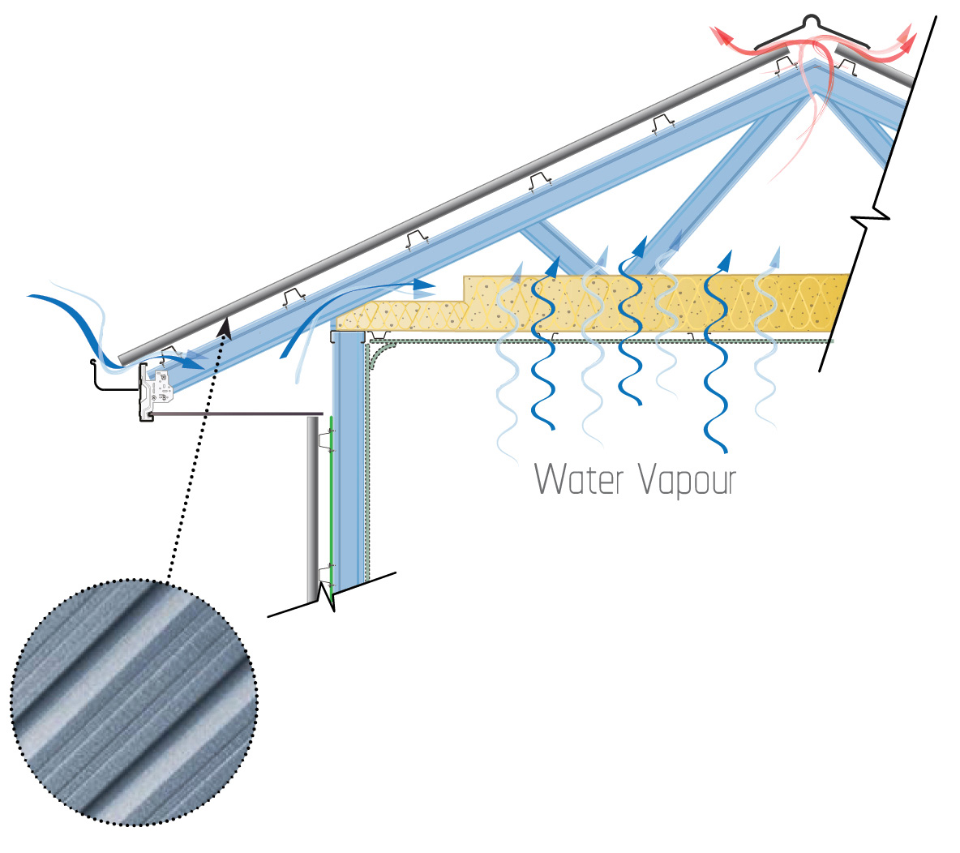
Alternative and New Approaches are Emerging
ALTERNATIVE
NEW
Increased humidity above membrane requires consideration of material durability and compatibility.
Membrane absorbs and releases moister in cycle with attic ventilation.
METAL ROOF + PERMEABLE MEMBRANE Breathable Membrane beneath roof sheet and water vapour passes through from roof attic. Above Membrane drainage and drying is necessary Roof Attic Ventilation is required
METAL ROOF + ABSORBANT MEMBRANE
Absorbent fleece is laminated to underside of roof sheet
Any Condensate is stored in the fleece to avoid dripping
Roof Attic Ventilation is necessary

Slide 10
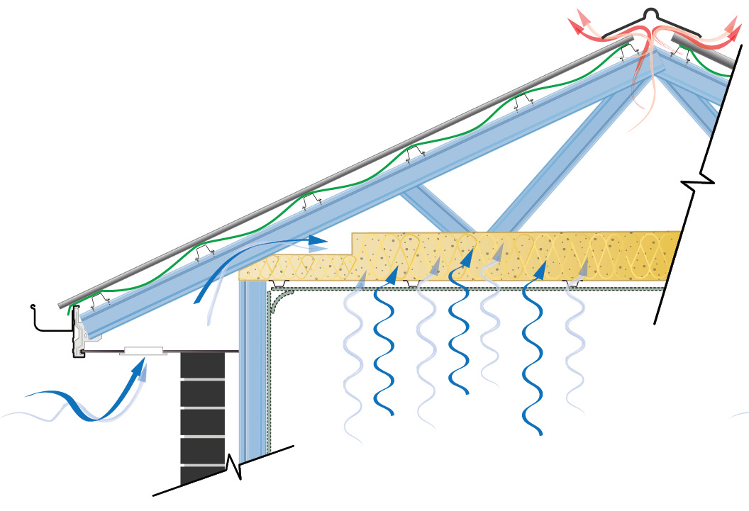
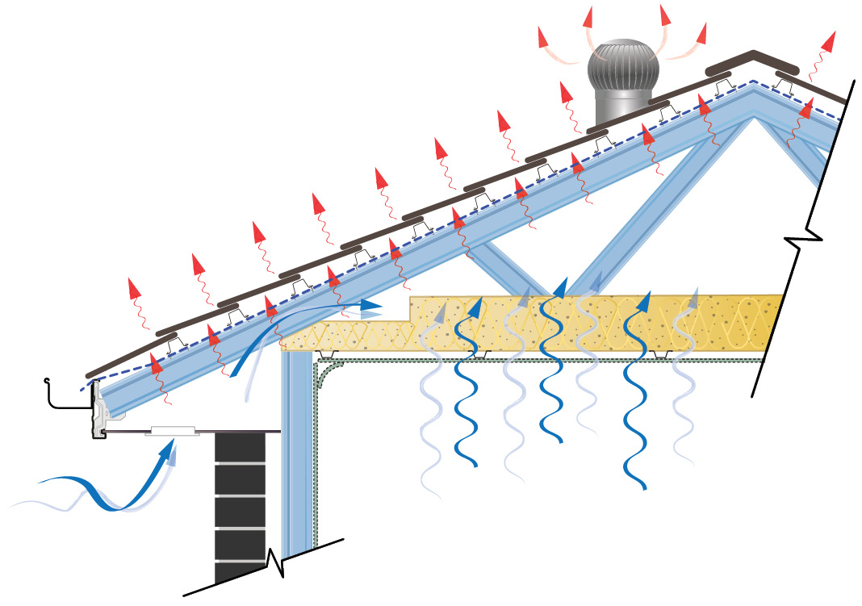
Where Roof Insulation or Sarking is Applied Consideration of Roof Ventilation is Needed
CORRUGATED SHEET STEEL ROOF
With ROOF INSULATION (VAPOUR BARRIER)
Thermal and Condensation control
EAVE Ventilation Requirement
With SARKING
Water control
EAVE Ventilation Requirement
TILED ROOF
With SARKING
Water control
EAVE and RIDGE Ventilation Requirements

Slide 11
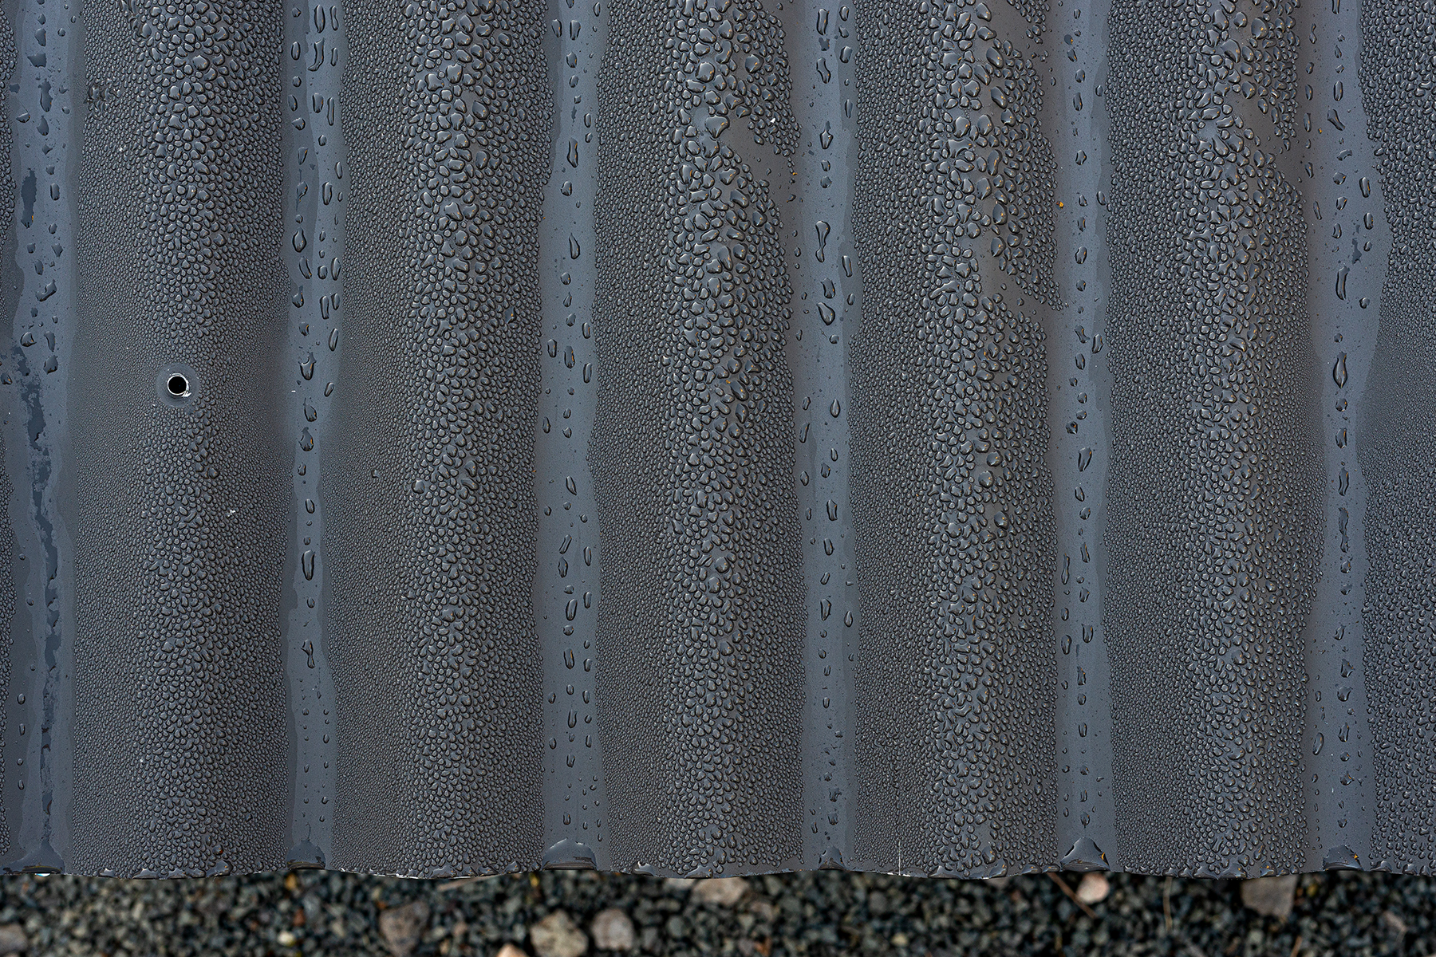
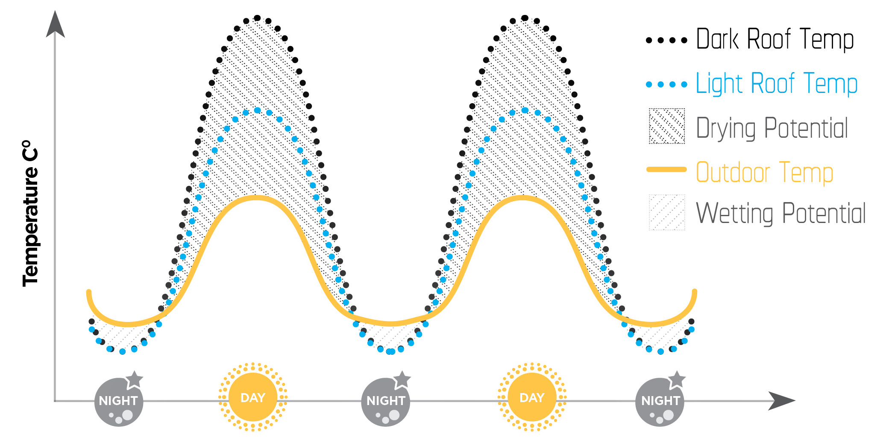
CASE STUDIES of How Steel Roofs Perform
Providing the construction industry with clarity and confidence
DRYING CYCLE is greater than WETTING CYCLES
TOP SURFACE
UNDER SURFACE

Slide 12
^{THANK YOU}
enquiries@steel.org.au

